Slide 1
A kinase switch for Lipid Transport?
Josh Derrick 6.29.2021

Slide 2
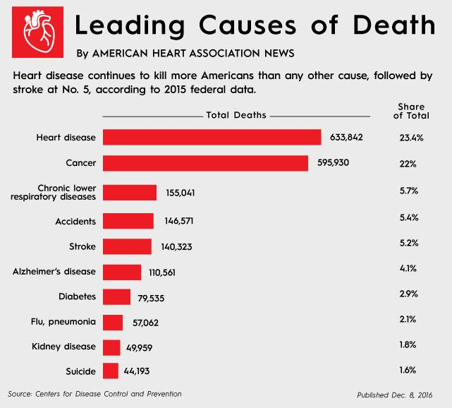

Slide 3
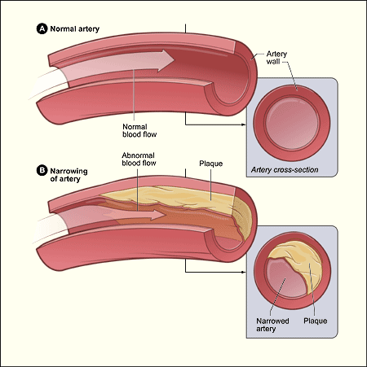
Atherosclerosis is a primary Cause of Heart Disease
UCSF

Slide 4
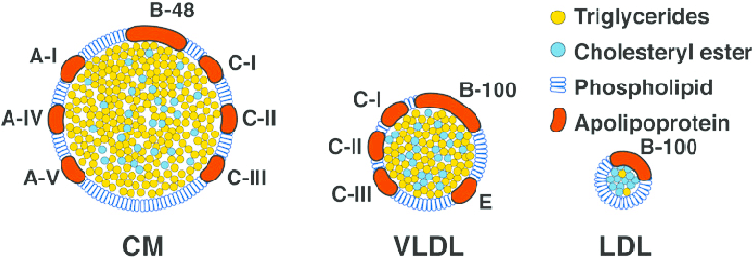
Lipoproteins are required to transport Hydrophobic Lipids throughout the body
Curcio et al., 2009

Slide 5
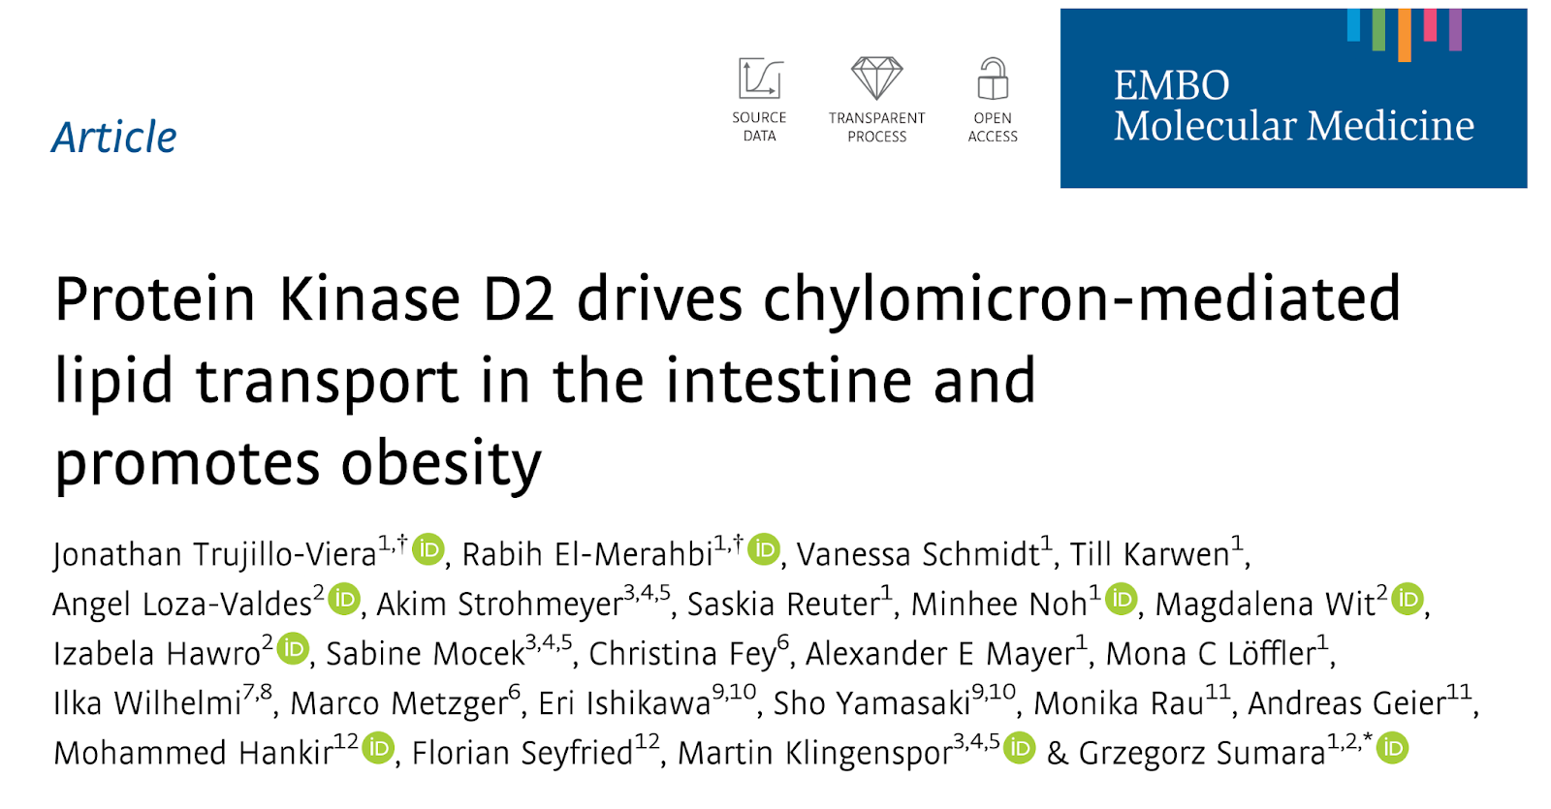

Slide 6
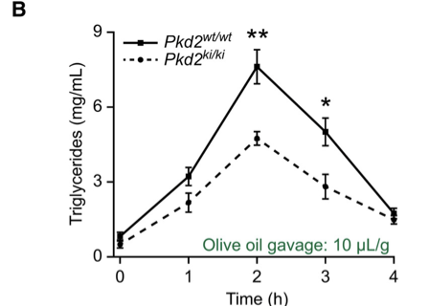
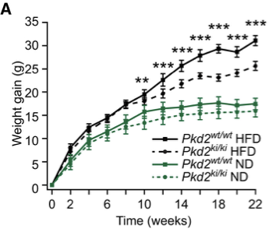
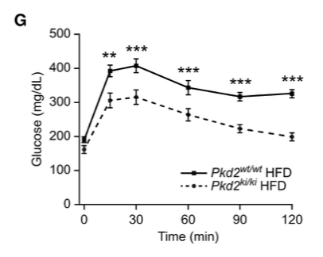
Mice without functioning kinase are resistant to obesogenic effects
Trujillo-Viera, 2021, EMBO

Slide 7
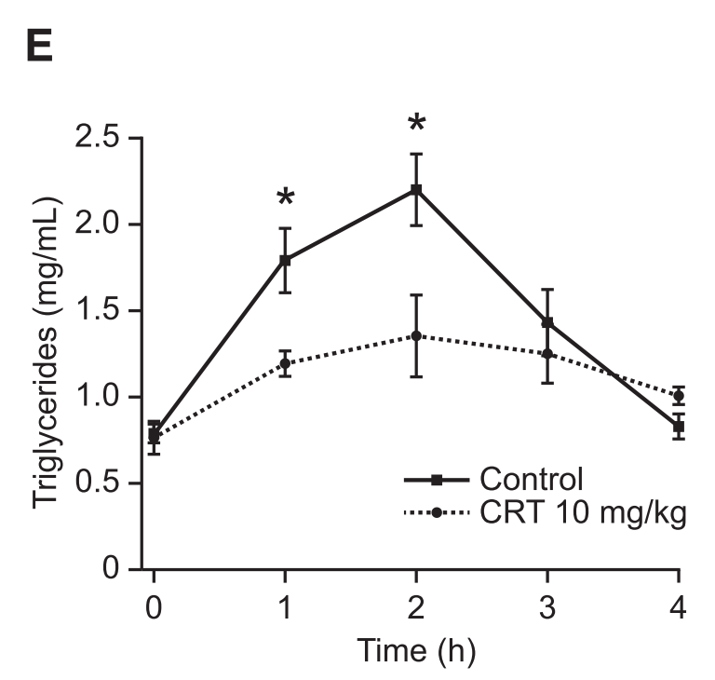
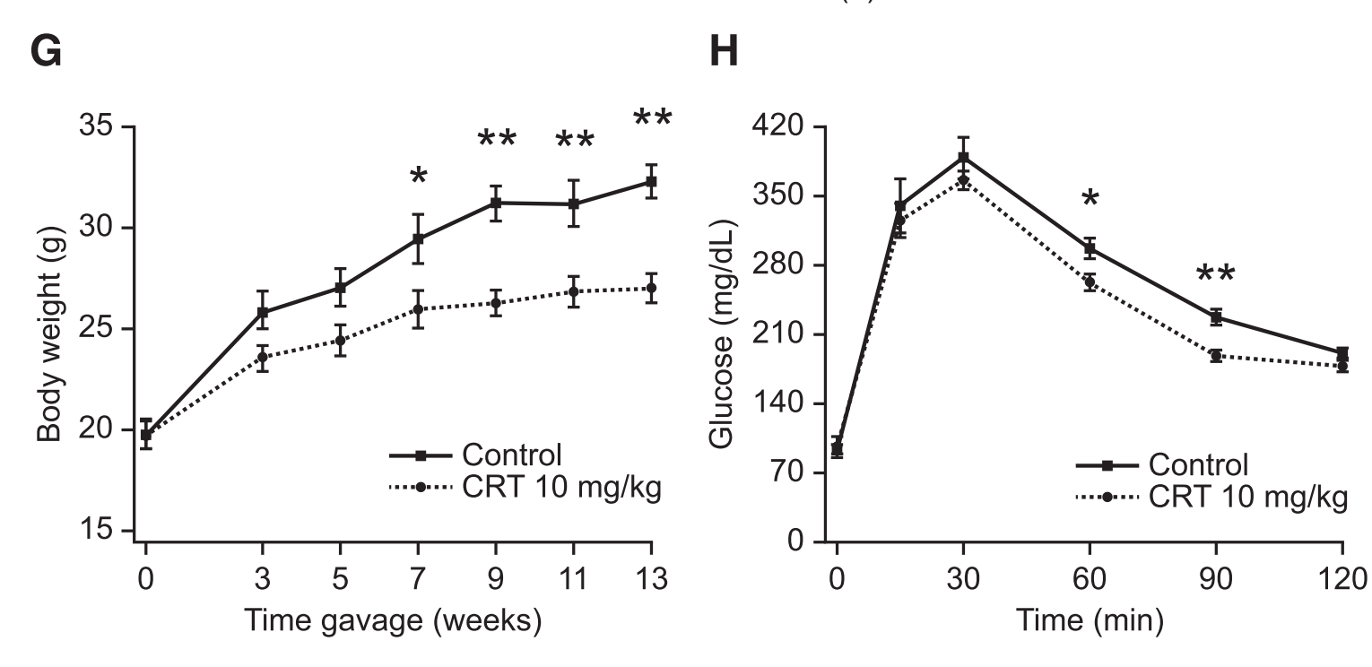
Phenotype is present with drug inhibition as well
Trujillo-Viera, 2021, EMBO

Slide 8
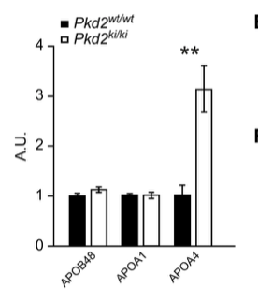
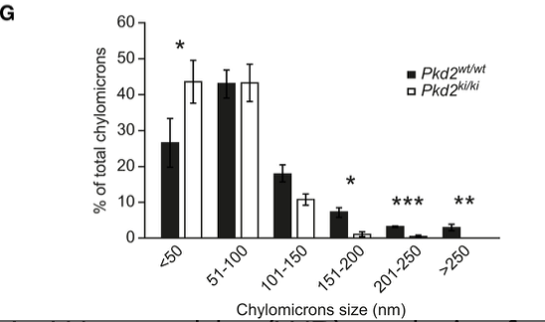
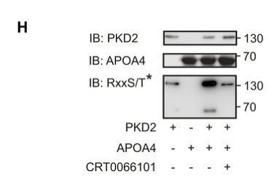
Effect is caused by chylomicron size decrease mediated by ApoA4?

Slide 9
Trujillo-Viera Model of PRKD2 action
Chylomicron/VLDL size
Lipid Transfer
CRT600602
PRKD2
ApoA4

Slide 10
Issues with this model
X
Chylomicron/VLDL size
Lipid Transfer
CRT600602
PRKD2
ApoA4
ApoA4 knockout does not impact obesity, very mild effect on lipid transfer! (Kohan, 2011 Verhauge, 2013)

Slide 11
Issues with this model
?
Chylomicron/VLDL size
Lipid Transfer
CRT600602
PRKD2
ApoA4
ApoA4 knockout has different effects on particle size depending on the particle/tissue (Kohan, 2011 Verhauge, 2013, Nhan’s data )

Slide 12
Issues with this model
ApoB
Chylomicron/VLDL size
Lipid Transfer
CRT600602
PRKD2
ApoA4
ApoA4 knockout should also affect particle number and thus ApoB levels but that wasn’t observed.

Slide 13
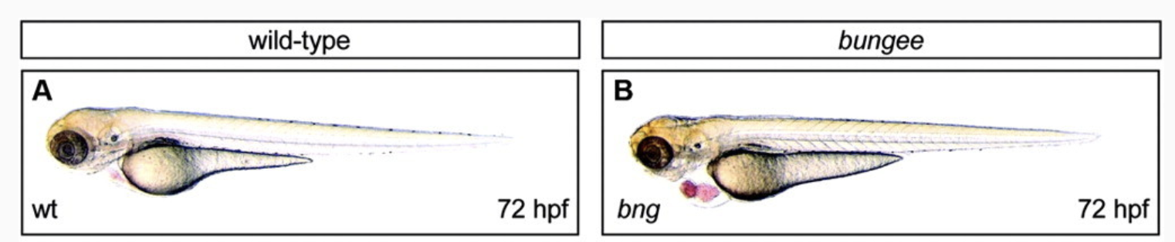
Can we resolve these contradictions in Zebrafish?
Just, 2011, Circulation

Slide 14
Can we resolve these contradictions in Zebrafish?
Heart Defect :(
Just, 2011, Circulation

Slide 15
Can we resolve these contradictions in Zebrafish?
Heart Defect :(
Dark Yolk :)
Just, 2011, Circulation

Slide 16
Project Goals and Hypotheses
Can we replicate the deficient fat transport phenotype of the Trujillo-Viera mice by targeting PRKD2 with genetic and pharmacological approaches while avoiding the heart defect observed by Just?
How does PRKD2 inhibition affect lipoprotein particle count and size, as visualized by ApoB-nluc?
Prediction: PRKD2 knockout will decrease particle count as well as particle size, as particle size alone has been shown not be associated with the anti-obesogenic phenotype observed

Slide 17
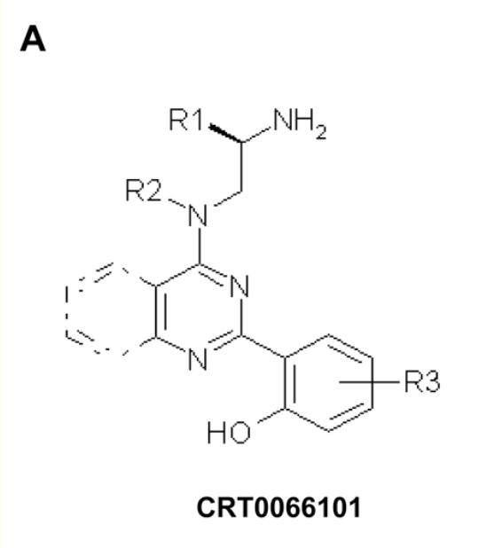
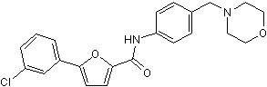
Drug Approach
CID2011756
IC50=0.7,0.6, 3.2 uM
IC50=1,2.5,2uM
Harikumar, 2010
Torcis

Slide 18
Drug Results: pilot
IC50 single treatment vs control DMSO (25 uL)
Took timepoints at 3,6,24 and 48 hrs
7 fish
Looked for dark yolk(none) and ApoB levels using nluc
Larvae from a single cross

Slide 19
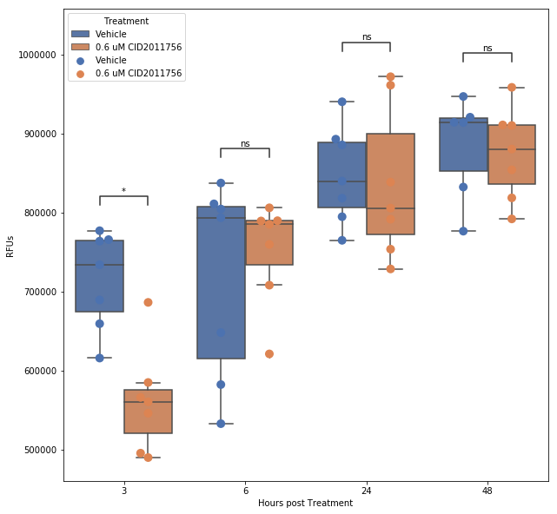
Drug Results: nluc from pilot assay

Slide 20
Drug Results: nluc from pilot assay
ns: 5.00e-02 < p <= 1.00e+00
*: 1.00e-02 < p <= 5.00e-02
**: 1.00e-03 < p <= 1.00e-02

Slide 21
Larger Experiment
Fish didn’t lay, freezer issues, etc. means I only got to do this yesterday
3 concentrations: 0.6 uM, 1.5 uM, 6uM
Timepoints: 1.5,3,4.5,6 hrs
8 technical, 3 biological replicates
Single dose

Slide 22
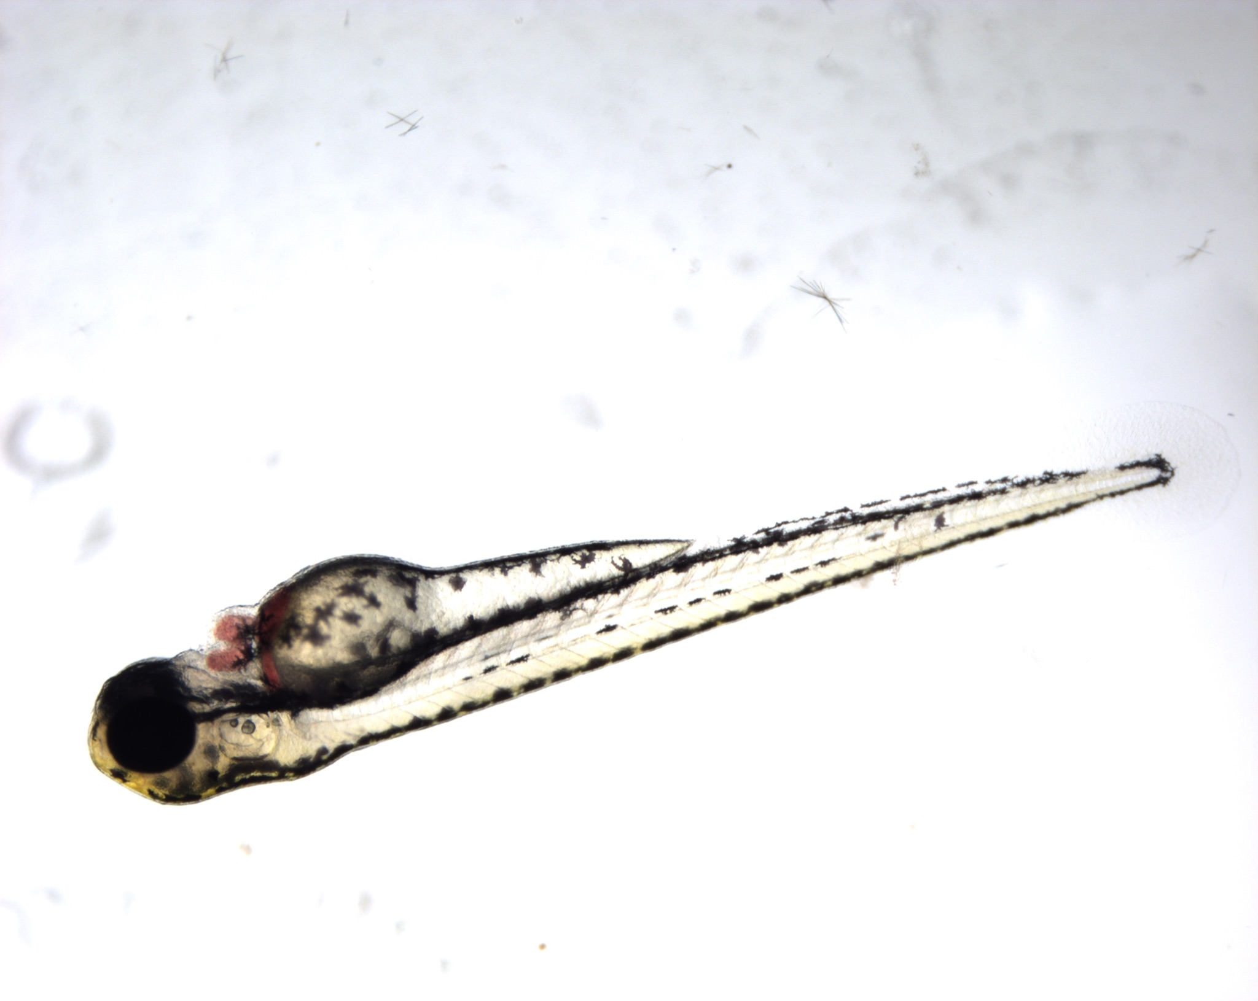
Drug Results: Blood Pooling Phenotype at 6uM
Started at 3 hrs
All fish at 6uM had phenotype (72/72))

Slide 23
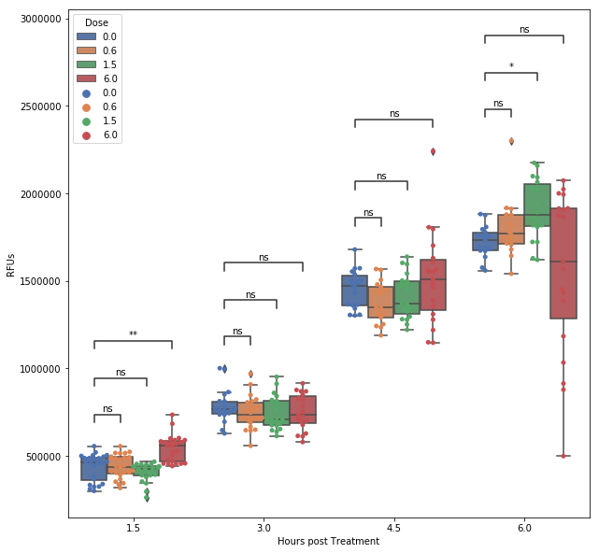
Drug Results: But little difference in lipoprotein particle count
ns: 5.00e-02 < p <= 1.00e+00
*: 1.00e-02 < p <= 5.00e-02
**: 1.00e-03 < p <= 1.00e-02

Slide 24
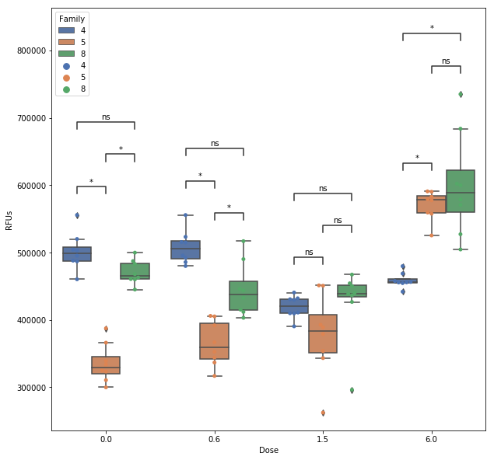
Large Variation at each timepoint between crosses
1.5 hrs post-treatment
ns: 5.00e-02 < p <= 1.00e+00
*: 1.00e-02 < p <= 5.00e-02
**: 1.00e-03 < p <= 1.00e-02

Slide 25
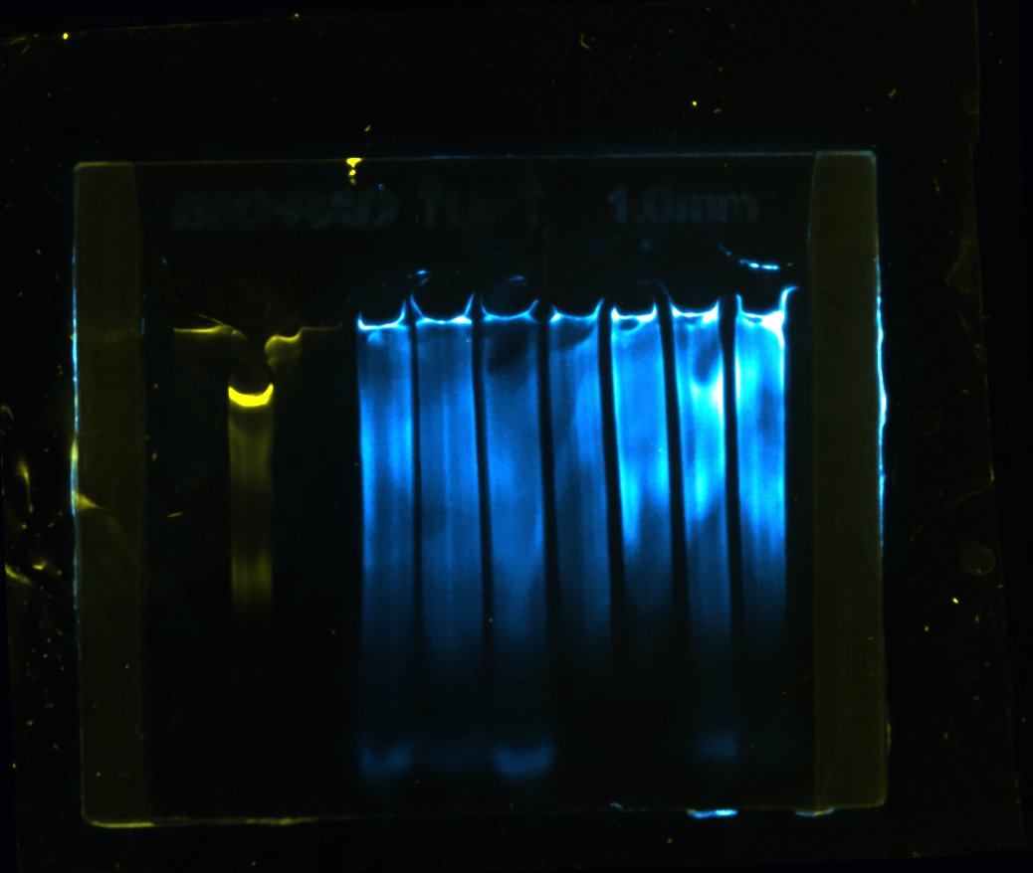
Lipoprotein Size not conclusively targeted either
Family 5
Family 8
Ladder
0.6
1.5
6
0.6
1.5
6
uM Drug Treatment

Slide 26
Screen: Future Directions
Screen adults or older larvae to avoid heart issues
Try other PRKD inhibitors. Only one came during my rotation.
Try inhibitor in ApoA4a KO background. If Trujillo model is correct, should see no difference between control and treatment

Slide 27
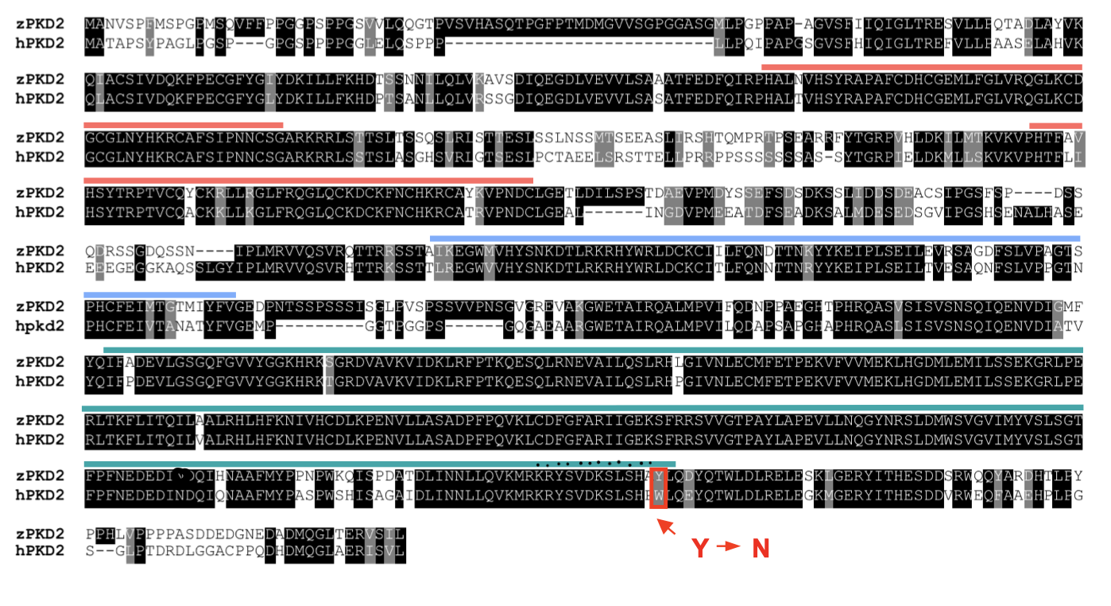
Genetic Approach
Just, 2011, Circulation
Heart Defect(849)

Slide 28
Genetic Approach
Trujillo-viera mutation (707,711)
Just, 2011, Circulation
Heart Defect(849)

Slide 29
Genetic Approach
PH domain
(419-554)
Trujillo-viera mutation (707,711)
Just, 2011, Circulation
Heart Defect(849)

Slide 30
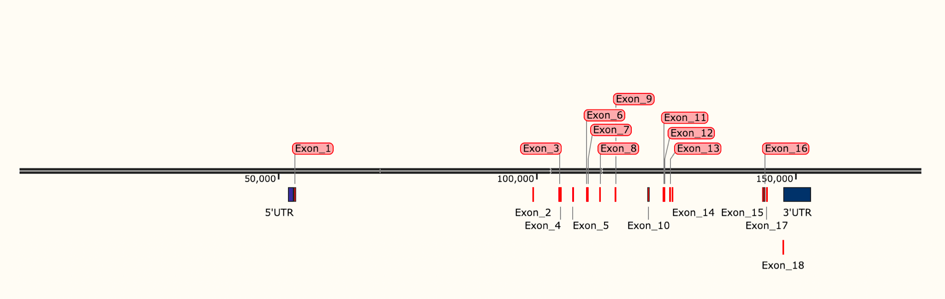
CRISPR knockouts
Knockout Whole gene

Slide 31
CRISPR knockouts
Knockout Whole gene
PH domain

Slide 32
CRISPR knockouts
Knockout Whole gene
Kinase
PH domain

Slide 33
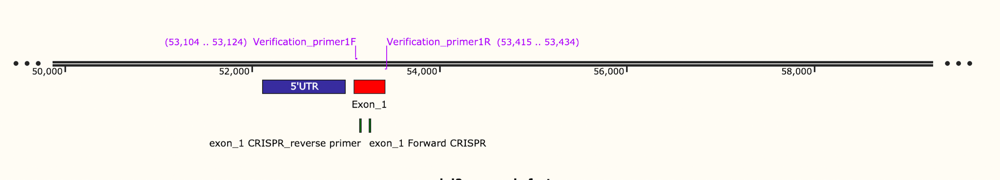
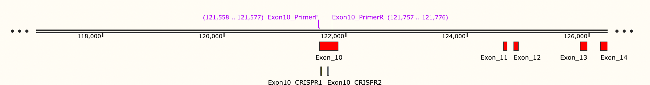
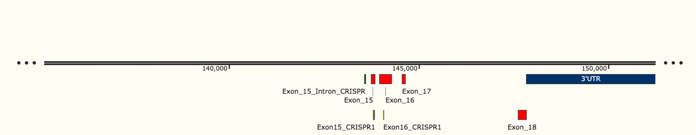
Exon 1: 20 bp or ~185 bp deletion
Exon 10: 20 bp or~135 bp deletion
Exon 15-16: 20 or 500 bp deletion

Slide 34
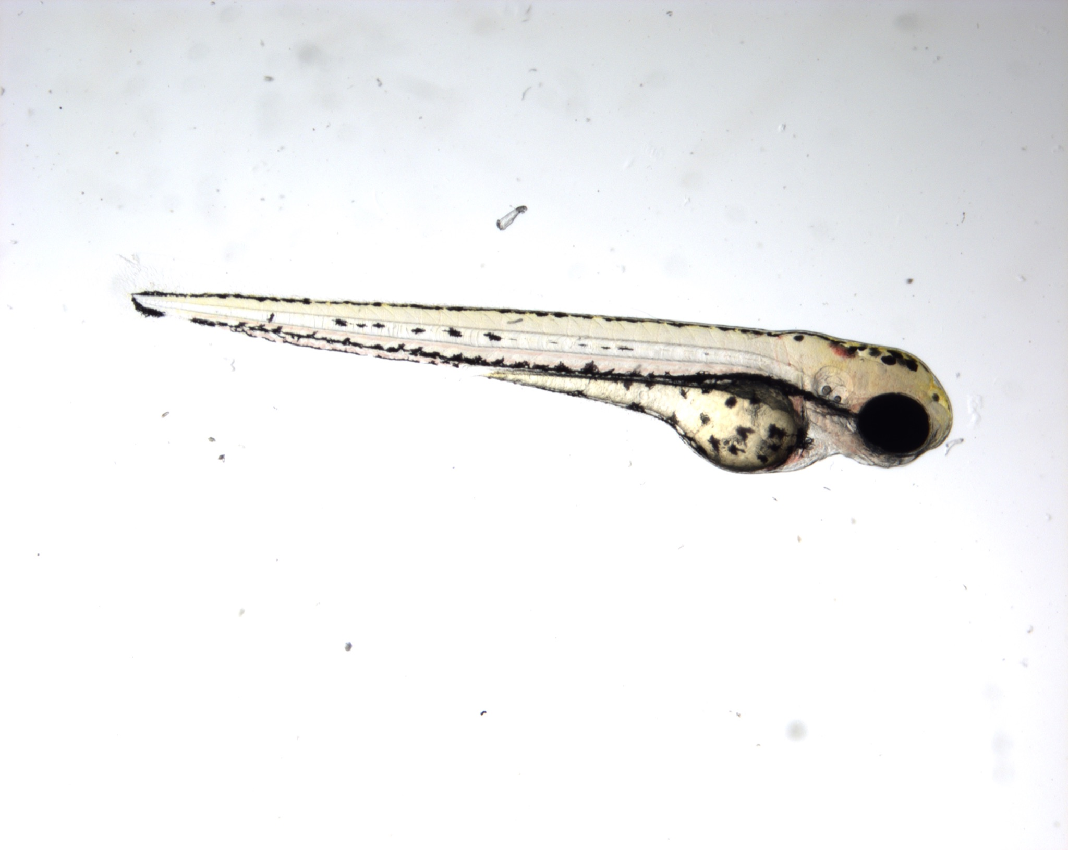
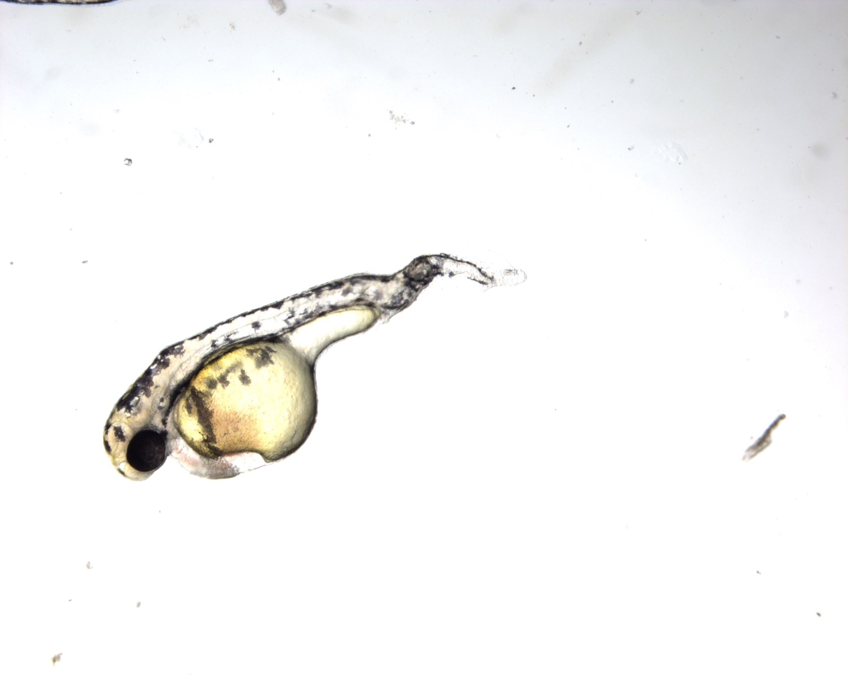
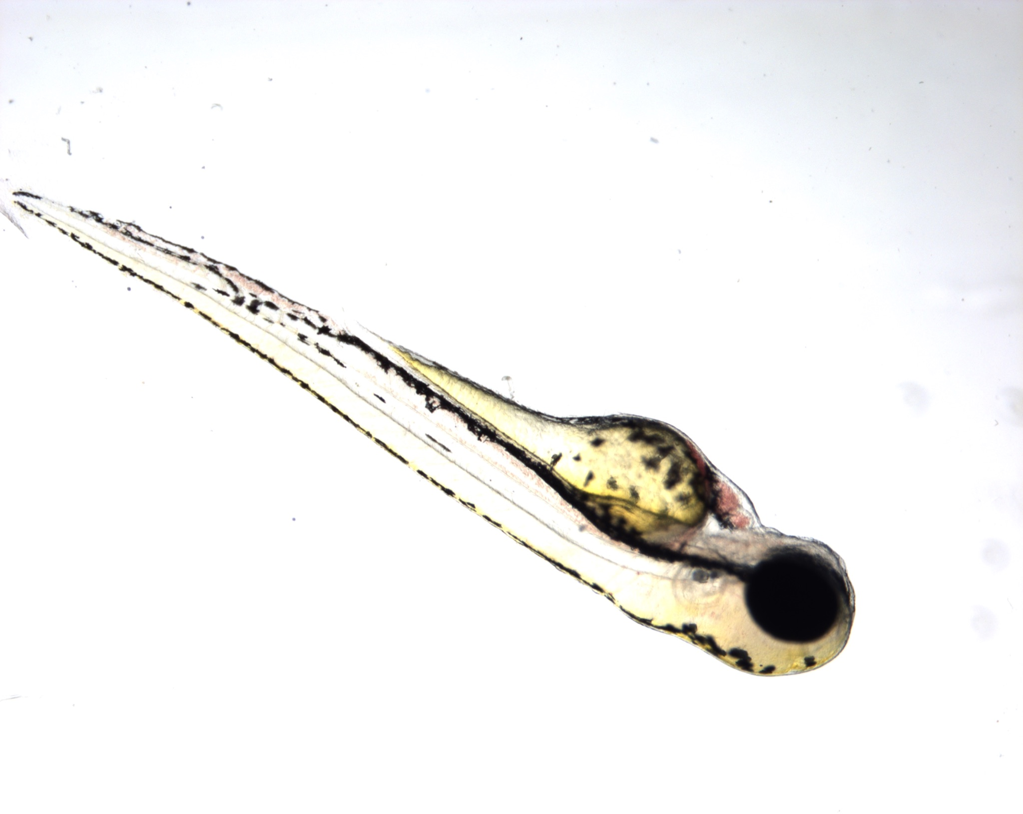
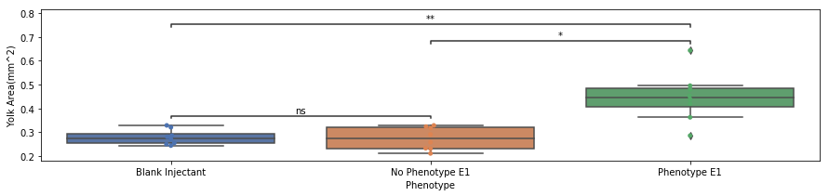
Significant Difference in Yolk size at 3 DPF
ns: 5.00e-02 < p <= 1.00e+00
*: 1.00e-02 < p <= 5.00e-02
**: 1.00e-03 < p <= 1.00e-02

Slide 35
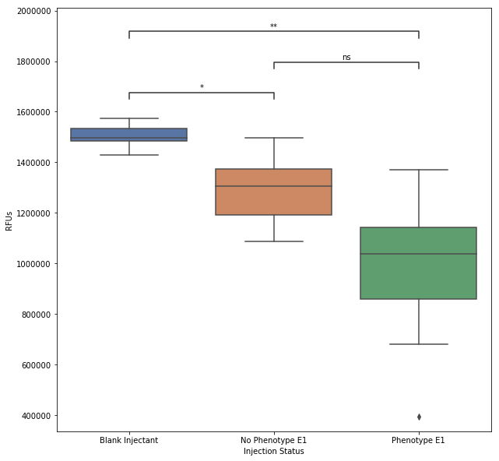
Significant Difference in Lipoprotein particle count
ns: 5.00e-02 < p <= 1.00e+00
*: 1.00e-02 < p <= 5.00e-02
**: 1.00e-03 < p <= 1.00e-02

Slide 36
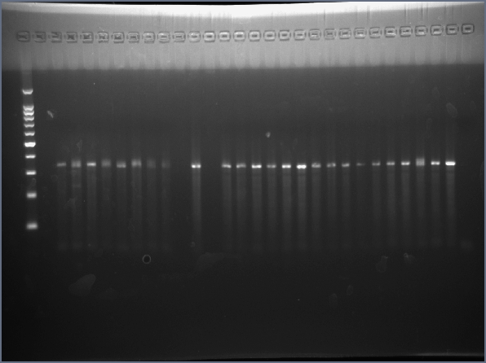
But Genotype is inconclusive
Phenotype
Control
No Phenotype
+
300 bp

Slide 37
But Genotype is inconclusive
Phenotype
Control
No Phenotype
+
300 bp
heteroduplex?

Slide 38
Genetic Approach Future Ideas
Use a (non-existent) ApoA4 reporter instead of ApoB
CRE-LoxP to avoid heart defect
Phosphomimetic or non-phosphorylatable ApoA4

Slide 39
Summarizing the ApoA4 conundrum
Mutant | Particle Size | ApoB(Lipoprotein particle count) | Metabolism
apoa4 KO | Larger Chylomicrons(Kohan) No Change(Nhan) Smaller VLDL(Verhauge) Lower VLDL(Weinstock | Less ApoB (Nhan, Kohan) | Lower Triglycerides in plasma (Kohan, Verhauge
apoa4 OE | Larger VLDL (Verhauge) No change (Nhan) | No Change (Nhan) | Higher Triglycerides
prkd2 KO | Smaller Chylomicrons | No Change (Trujillo-Viero) Lower (Josh) | Lower Triglycerides in plasma

Slide 40
Conclusions
CID2011756 inhibition of PRDK2 does not conclusively target the lipoprotein pathway, and has off-target, damaging effects at higher doses

Slide 41
Conclusions
CID2011756 inhibition of PRDK2 does not conclusively target the lipoprotein pathway, and has off-target, damaging effects at higher doses
However CRISPR mutant to the locus changes ApoB levels and yolk utilization

Slide 42
Conclusions
CID2011756 inhibition of PRDK2 does not conclusively target the lipoprotein pathway, and has off-target, damaging effects at higher doses
However CRISPR mutant to the locus changes ApoB levels and yolk utilization
Really need an ApoA4 reporter

Slide 43
Thank you everyone!
PI: Steve Farber
Research Scientists:
Jen Anderson
Postdocs:
McKenna Feltes
Lishann Ingram
James Therier
Meredith Wilson
Yang Jin
Dan Kelpsch
Technicians:
Monica Hensley
Maggie Shen
Undergrads:
Jeffery Shin
Sofia Angel
Graduate Students:
Darby Kozan
Michelle Biederman
Tabea Moll
...And the fish

